Slide 1

WELCOME
ON
MY PRESENTATION
Md.Aminul Islam
Senior teacher
Chandpur Ahamadia Fazil madrasah
Chandpur

Slide 2


CLASS-SIX
GENERAL SCIENCE
Index

Slide 3
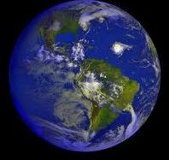
Worm Up
Index
Index

Slide 4
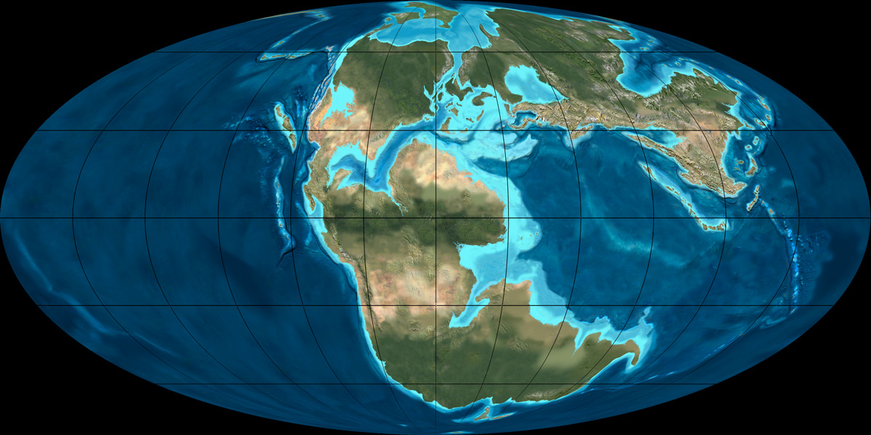
What do you see in the picture?
Index

Slide 5
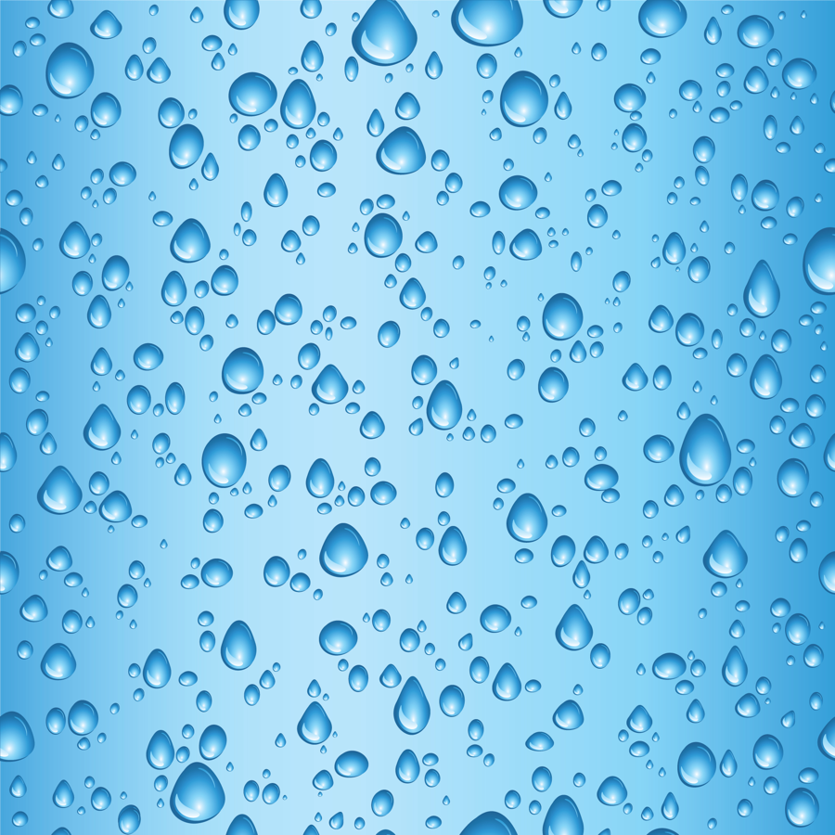
WATER

Slide 6
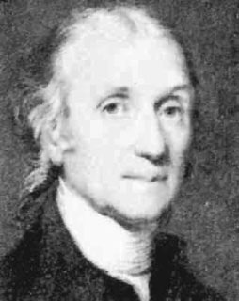
He proves that water is a compound mater.
Cavendish-1781
2H2
O2
2H2o
Index

Slide 7
Water Chemical Properties
-
-
H
H
Two atoms of hydrogen
o
One atom of oxygen
+
Index

Slide 8
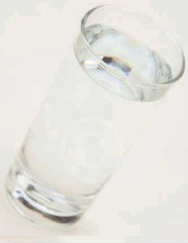
Percentage of water in the world
There is 97% of all the water on the earth
Is in the ocean and only 3% is fresh water.
That leaves 2% frozen and out of that
Less than 1% for drinking water.
Index

Slide 9
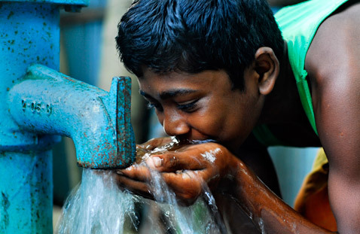
Water to drink
66% of the human body is made up of water.
At just 2% dehydration your performance decreases by around 20%.
We should drink at least 1½ litres of water a day.
Index

Slide 10
World Water Uses
Index

Slide 11




Importance of water
Water is essential to build life cell.
Water solutes elements of food which builds our body.
Blood’s water transfers the food whole body
And these food builds the body and produces energy.
Polluted elements of the body go out with water.
To wash cloth.
Index

Slide 12


To bathe.
To cook and wash pots.
Water is used to produce electricity.
It is used all kinds of factory.
It is used to produce crops ,fruits and vegetables.
Plants use water to build their food.
co2+H2O
sunlight
C6H12O6+O2+H2O
Clorofile
Index

Slide 13
Electrolysis of water
Index

Slide 14
Source of water
Source
of water
Fallse
Ocean
River
Rain

Slide 15
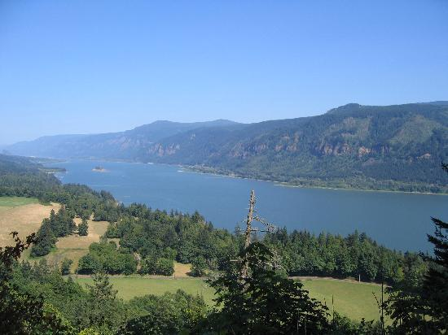
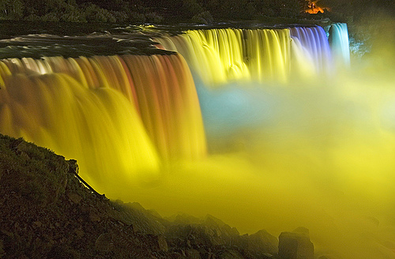
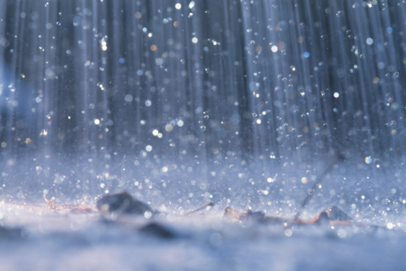
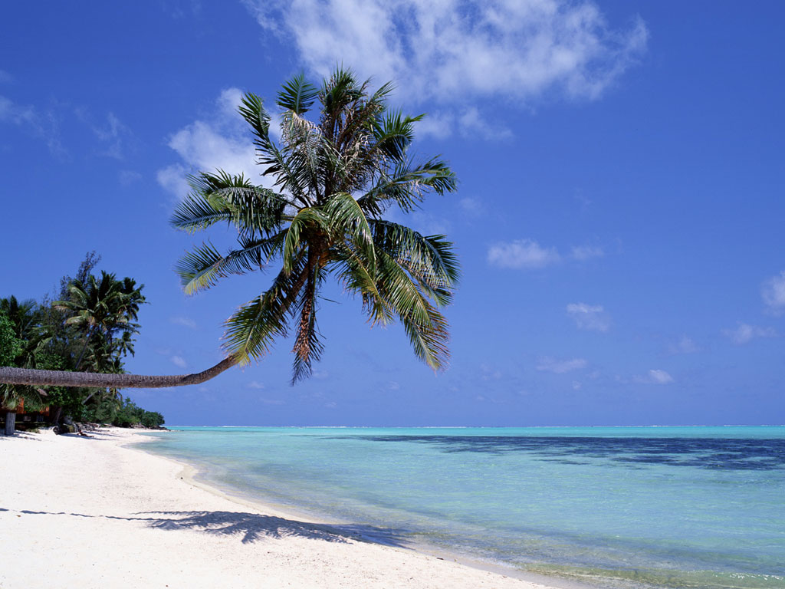
Source of Water
FALLSE
RIVER
RAIN
OCEAN

Slide 16
Mind Map
Forms of water
.
.
.
Index

Slide 17
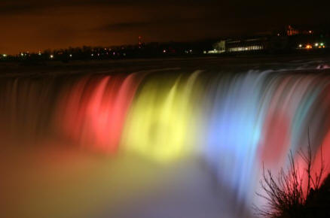
Forms of water
Index

Slide 18
The Three forms of Water.
Solids: When water becomes very cold and freezes it will change from a liquid to a solid. It has a definite form and shape.
Liquids: When water takes the shape of its container it is in a liquid form.
Gases: When water is seen in a vapor form and has no definite size or shape it is in a gas form.
Index

Slide 19
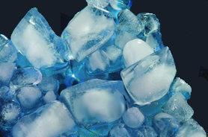
Solids
We see it
In ice
Index

Slide 20
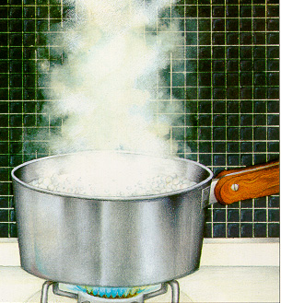
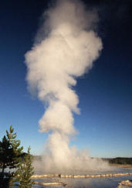
Steam is water in a gaseous form.
Water also becomes a gas when it evaporates,
Or when you see a geyser or hot pots.
Index

Slide 21
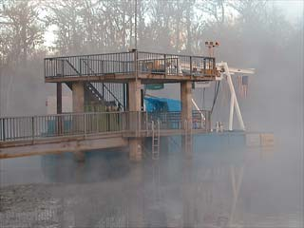
Fog

Slide 22
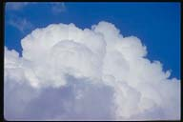
Gases
You see water in the form of gas, when you see……..
Clouds
Index

Slide 23
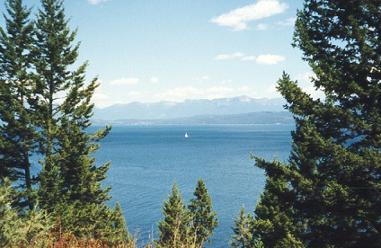
In nature we see water in its liquid form.

Slide 24
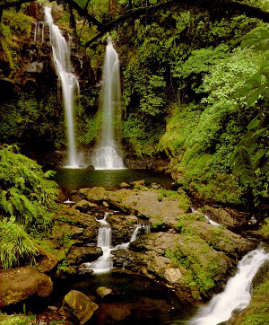
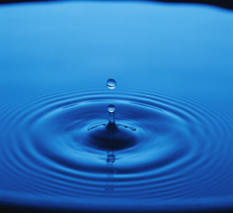
Liquids
Rain
Lake

Slide 25
GROUP WORK
CAVINDISH
Describe about the electrolysis of water.
HURVEY
What is the importance of water?
ROSS
Describe the source of water.

Slide 26

EVALUATION
FILL IN THEN BLANKS:
Water is essential for our ____________.
Human and plants does not live without _________.
Plants use ______ when they produce their food
by the reaction of photosynthesis.
Index

Slide 27
HOME WORK
DESCRIBE ABOUT THE FORMS OF WATER.
Index

Slide 28


THANK YOU ALL
Index

Slide 29
INDEX
Worm up
Lesson announcement
What is water
World Water Uses
Importance of water
Electrolysis of water
Forms of water
Group work
Evaluation
Home work
Thanks
Index

